Slide 1
Multi Dimensional Variance:
How to make ultra flexible software!

Slide 2
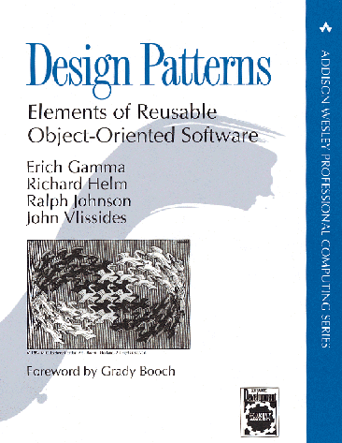
Goal and means to an end?
Patterns:
Goal in itself or just the means to an end?
Patterns are interesting as means to achieve some specific quality in our software:
  elements of Reusable ...
A key aspect is handling variance
© Henrik Bærbak Christensen

Slide 3
Variance
Factoring out in roles and delegating to objects that play roles is a very strong technique to handle multiple dimensions of variance!
  that is – a piece of software that must handle different types of context
    work on both Oracle and MS database
    work in both debug and production environment
    work both with real hardware attached or simulated environment
    work with variations for four different customers
Here all types of combinations are viable !
© Henrik Bærbak Christensen

Slide 4
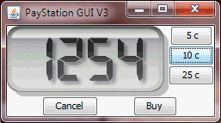
New Requirements
Alphatown county wants the display to show parking end time instead of minutes bought!
© Henrik Bærbak Christensen

Slide 5
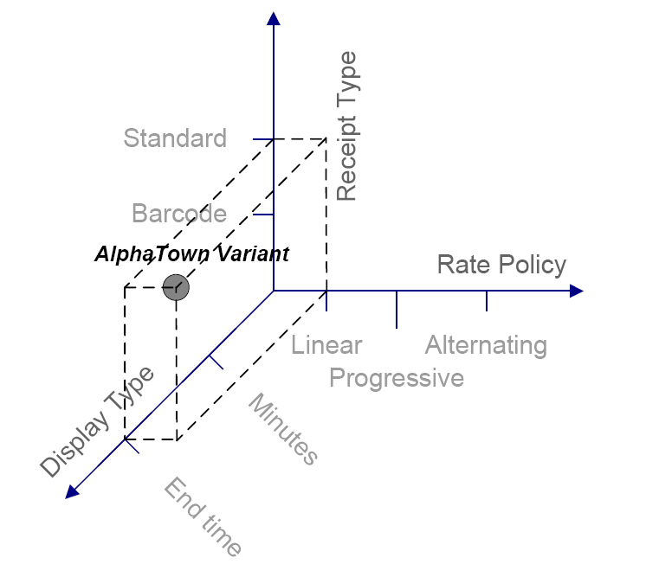
Combinatorial explosion!
All these requirements pose a combinatorial explosion of variants ☹
There are 3*2*2 = 12 combinations. This may be doubled if we include
overriding weekend day algorithm !
© Henrik Bærbak Christensen

Slide 6
Variance by switching
Variant handling by #ifdef’s or switching is well known, but the code simply bloats with conditional statements.
Example: GNU C compiler has a single statement that includes 41 macro expansions !!!
I wonder what that code does???
#ifdef ( MSDOS && ORACLE || MYSQL && …)
#ifdef ( DEBUG )
  quickly you loose control of what is going on…
© Henrik Bærbak Christensen

Slide 7
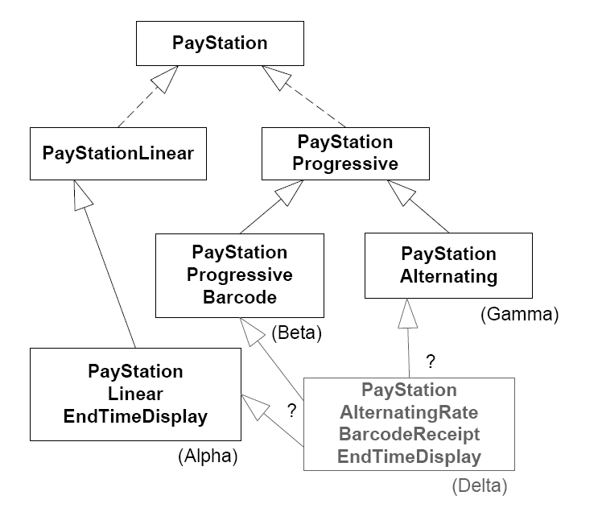
Variance by inheritance
Inheritance dies miserably facing this challenge!
Just look at names!
Making new variants is
difficult.
And code reuse is very
difficult ☹
© Henrik Bærbak Christensen

Slide 8
Masking the problem
By combining inheritance and switching you may mask the problem somewhat.
I.e. handle receipt type by inheritance, and the rest by pumping the code with if’s…
but … it is still an inferior way to handle multi-dimensional variance…
© Henrik Bærbak Christensen

Slide 9
Compositional software
The way forward is:
Compositional software
Highly configurable and flexible software!
③ Consider what behaviour that may vary
① Express variable behaviour as a responsibility clearly defined by an interface
② Delegate to object serving the responsibility to perform behaviour
© Henrik Bærbak Christensen

Slide 10
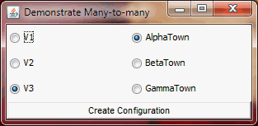
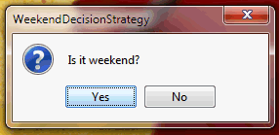
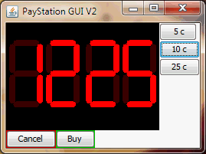
Compositional software
[Demo]
© Henrik Bærbak Christensen
Notes:
dSoftArk 2009 – codelab / many-to-many

Slide 11
Compositional Software
[Backgammon Demo]
© Henrik Bærbak Christensen

Slide 12
Compositional software
The parking machine has become a team leader, delegating jobs to his specialist workers:
Note! No if’s – no bloat – easy to read code leading to fewer bugs!
public int readDisplay() {
return displayStrategy.reading();
}
timeBought = rateStrategy.calculateTime(insertedSoFar);
public Receipt buy() {
Receipt recipt = factory.createReceipt( this );
resetTransaction();
return recipt;
}
© Henrik Bærbak Christensen

Slide 13
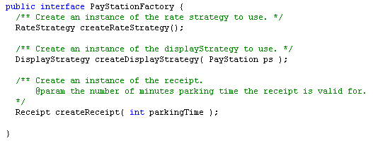
Compositional software
Telling the team leader which persons will serve the roles:
The factory interface
© Henrik Bærbak Christensen

Slide 14
Compositional software
Creating a parking machine:
  create the factory
  create the pay station, giving it access to the factory
PayStationFactory psf = new AlphaTownFactory();
PayStation pm = new PayStationImpl( psf );
© Henrik Bærbak Christensen

Slide 15
Compositional software
... and a factory:
class AlphaTownFactory : PayStationFactory {
public RateStrategy createRateStrategy() {
return new LinearRateStrategy();
}
public DisplayStrategy createDisplayStrategy() {
return new EndTimeDisplayStrategy();
}
public Receipt createReceipt( int parkingTime ) {
return new StandardReceipt(parkingTime);
}
}
© Henrik Bærbak Christensen

Slide 16
Analysis
Benefits
  The variability points are independent
    we introduced new display strategy – but this did not alter any of the existing strategies !
  Once the variability point has been introduced we can introduce as many new types of variations as we like – only by adding new classes
    any price model; new receipt types; new display output...
  Open-closed principle in action...
public int readDisplay() {
return displayStrategy.reading();
}
© Henrik Bærbak Christensen
Notes:
open to extension /

Slide 17
Open/Closed principle
Open for extension
Closed for modification
© Henrik Bærbak Christensen

Slide 18
Analysis
Benefits
  Any combination it is possible to “mix”
  Nonsense combinations can be delimited
    abstract factory is the place to “mix” the cocktails
  Code readability
    every aspect of the configuration is clearly defined in a single place
      configuration mixing in the abstract factory
      orchestration in the Parking Machine impl
      each variation type in its own implementing class
© Henrik Bærbak Christensen

Slide 19
Analysis
Liabilities
  Each dimension of variability (price model, receipt type, display output, etc) is really independent – so
  we cannot feed information from one to the other ☹
  Example:
    The Alternating Rate policy needs to know whether it is weekend or not – but this is separated in a special strategy – thus the one needs the other...
  But – of course we can handle this – by a pattern ☺
© Henrik Bærbak Christensen

Slide 20
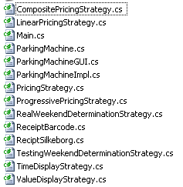
Analysis
Liabilities
The number of classes in action ☹
On the other hand:
  careful naming makes it
  possible to quickly identify
  which class to change…
© Henrik Bærbak Christensen

Slide 21
Analysis
Liabilities
  Actually I have a combinatorial explosion of factories! I need a factory for each and every combination of delegates that I have
  Exercise: How can I avoid this explosion?
© Henrik Bærbak Christensen

Slide 22
Summary
Handle multi-dimensional variance by compositional software designs !
© Henrik Bærbak Christensen

